Slide 1
Operating System

Slide 2
Contents
What is Operating system?
Types of Operating System
Kernel
Executive Services

Slide 3
Kernel
Kernel is the core or Heart of Operating System.
The kernel is a computer program that is the core of a computer’s operating system with complete control over everything in the system.
It is One of the first program loaded on start up

Slide 4
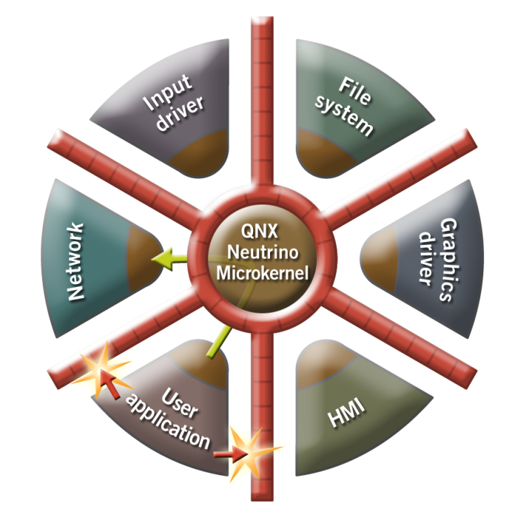
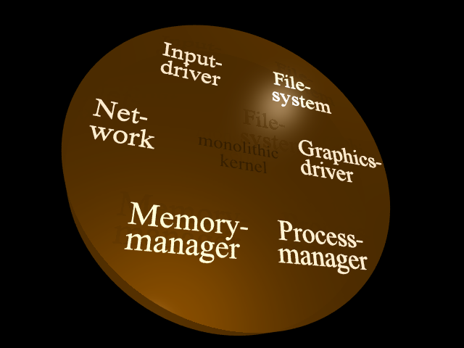
Types of Kernel
Monolithic Micro Kernel

Slide 5
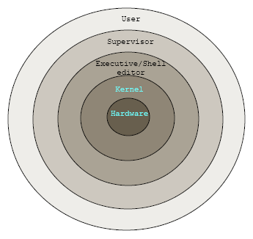
Hybrid Kernel

Slide 6
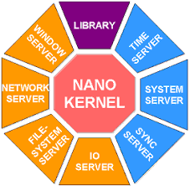
Nano Kernel
Nano was developed by ADEOS.
Widely using in Mobiles.

